Slide 1
Big Mountain Ski Resort

Slide 2
Big Mountain Ski Resort Problem Statement
Big Mountain Ski Resort is a large ski resort in Montana that caters to 350,000 visitors per year who ski or snowboard their 105 trails.
Big Mountain Ski Resort facilities can accommodate skiers and snowboarders of all levels and abilities the resort is serviced by 11 lifts, 2 T-bars, and 1 magic carpet for novice skiers. The longest run is named Hellfire and is 3.3 miles in length. The base elevation is 4,464 ft, and the summit is 6,817 ft with a vertical drop of 2,353 ft.
Big Mountain Ski Resort Management team currently charges a premium above an industry average ticket price and suspects there is much room for improvement for this pricing method.

Slide 3
Recommendations and Key Findings
The various modeling techniques used converged on the attributes to be used as statistically significant for predictive inputs: Fast Quads, Runs, Snow Making acres, Vertical Drop
The predictive models derived four options for the management team to consider and only one is predicted to increase ticket price: Increase the vertical drop by adding a run to a point 150 feet lower down but requiring the installation of an additional chair lift to bring skiers back up, without additional snow making coverage is predicted to increase ticket price by $8.61.
Big Mountain Resort modelled price is $95.87, and the actual price is $81.00. It is reasonable to assume that some of the other resorts used in deriving the predictive model under charged and some over charged thus evening out the predicted price of $95.87.

Slide 4
Modeling Results and Analysis I
The Exploratory Data Analysis phase discovered noise in the data regarding state size in acres or state size in population so two new scaling columns would be useful to standardize per 100K of state population.
Resort and state summary data attributes merged:
resorts_per_state
state_total_skiable_area_ac
state_total_days_open
state_total_terrain_parks
state_total_nightskiing_ac
resorts_per_100kcapita
resorts_per_100ksq_mile

Slide 5
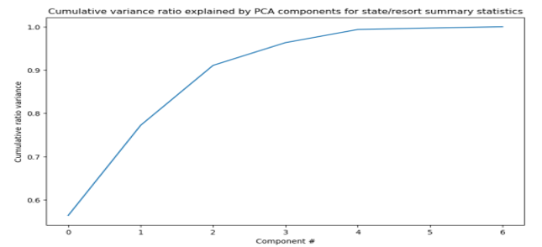
Modeling Results and Analysis II
The first two components of the resort/state summary seem to account for over 75% of the variance, and the first four components for over 95% of the variance.

Slide 6

Modeling Results and Analysis III
Four "new state resort competition" features were added to the merged state summary/ski resort data: ratio of resort skiable area to total state skiable area; ratio of resort days open to total state days open; ratio of resort terrain park count to total state terrain park count; ratio of resort night skiing area to total state night skiing area
A Pairwise Correlation Matrix was executed on all ski resort attributes to view relationships between attributes (e.g.:trams correlated to trams = 1)

Slide 7
Modeling Results and Analysis IV
As a baseline before training machine learning models the average price of $63.81 was noted. Since many features measured were listed in many different units, we scaled them to put them all on a consistent scale of mean zero and unit variance.
The select K best algorithm arrived at 8 coefficients which largely aligned with our correlation analysis in the EDA phase. Next, we looked at the Random Forest model and its top four coefficients for prediction coincided with the previous linear regression model: fastQuads, Runs, Snow_Making_ac, vertical_drop.
A predictive function was written that calculates a new value as new independent variables are added as inputs to the predictive function.

Slide 8
Summary and Conclusion
Examining the data appeared to raise more questions than it answered and highlighted the tradeoff between gathering more data and the incremental cost incurred.
It would also be worthwhile to investigate removing the least useful features from the predictive models and perhaps performing sensitivity analysis.
It is very re-assuring to observe that different models indicate the same features as statistically significant as inputs.
Of the four options short listed by management one option is optimal since dropping x number of runs reduces ticket price support and the other two either had no effect on ticket price or ran into the diminishing law of returns. It is reasonable to assume that some of the other resorts used in deriving the predictive model under charged and some over charged thus evening out the predicted price of $95.87.

